Slide 1




Sti
TITLE PAGE
•Problem Statement Title –Phishing Detection and Awareness Tool
•Theme –Cyber security
•Team ID - TOKSHA21
•Team Name (Registered on Website) - SHADOW BYTES
•Participant Names – T.M.Dinesh(24D45A6206)
P.Kumar Reddy (23D41A6246)
Ch.Harish(23D41A6211)
U.Sridhar(24D45A6203)
Sri Indu College of Engg & Tech - Cyber Club, Department of Cyber Security
Page 01

Slide 2

Shadow
Bytes
IDEA TITLE
Phishing Detection Tool: A browser extension that scans websites for signs of phishing, such as suspicious URLs and security issues like missing SSL certificates. It also checks email links for authenticity and alerts users when they visit malicious sites.
Phishing Awareness Tool: Educates users on identifying phishing attempts through interactive training, such as simulated phishing emails, and provides real-time feedback when potential threats are detected.
This solution addresses the problem by not only blocking phishing attacks but also teaching users how to recognize threats themselves. Its innovation lies in its hybrid approach—combining detection with education.
Sri Indu College of Engg & Tech - Cyber Club, Department of Cyber Security
Page 02

Slide 3
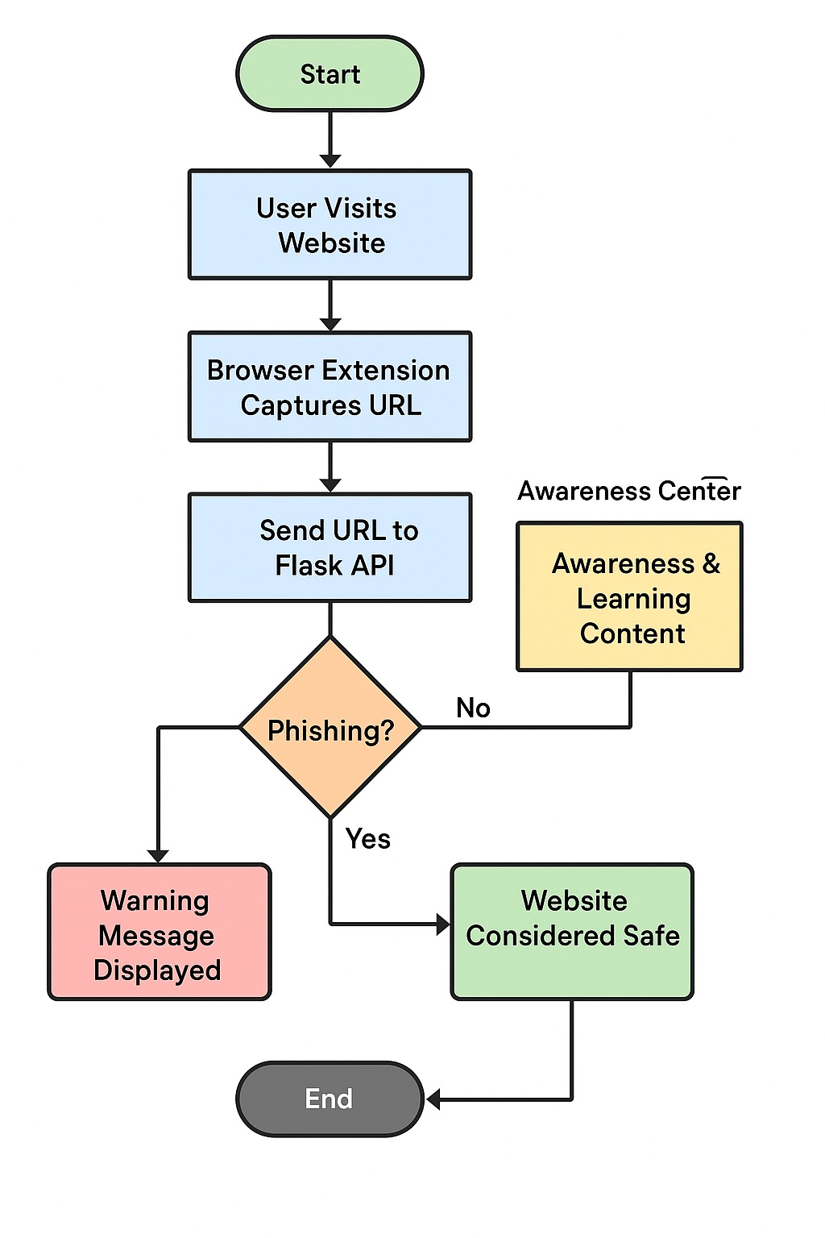
TECHNICAL APPROACH
Shadow
Bytes
Frontend: HTML, CSS, JavaScript (React.js or Vue.js)
Backend: Python (Flask/Django) with a machine learning library (e.g., scikit-learn, TensorFlow)
Phishing Detection Algorithm: A trained machine learning model (like Random Forest or SVM), or predefined rules.
Database: SQLite or PostgreSQL (for storing training data, URLs, and user results)
Hosting: You can deploy it on platforms like Render, Heroku, or AWS.
Sri Indu College of Engg & Tech - Cyber Club, Department of Cyber Security
Page 03

Slide 4
FEASIBILITY AND VIABILITY
Shadow
Bytes
•
Feasibility Analysis
✔️ Technically Feasible
Email APIs like Gmail API and Microsoft Graph API support secure access to user inboxes.
Phishing detection via machine learning, blacklists, and NLP is well-established.
Potential Challenges & Risks
False positives can cause email disruptions, while false negatives expose users to risk.
Gaining access to emails or browsing behavior raises serious privacy concerns.
Too many alerts or training reminders can annoy users, reducing effectiveness.
🛡️ Strategies to Overcome Challenges
Clearly explain what data is accessed, store as little as possible, and use encryption (at rest and in transit). Minimize email content storage.
Sri Indu College of Engg & Tech - Cyber Club, Department of Cyber Security
Page 04

Slide 5
IMPACT AND BENEFITS
Shadow
Bytes
🌐 Impact
Organizational: Reduces cybersecurity incidents significantly, fostering a stronger security culture.
Financial: Lowers costs of breaches, which can reach millions of dollars.
User: Builds user confidence by making them aware of phishing risks.
Strategic: Positions the company as proactive in cybersecurity, improving customer trust.
🎯 Benefits
Prevents Phishing: Detects and blocks phishing emails automatically, reducing security risks.
User Education: Provides instant training when risky actions are detected (like clicking a phishing link).
Saves Time: Automates threat detection and reduces IT workload by flagging suspicious emails.
Data Insights: Tracks users' phishing risk levels and identifies vulnerable areas.
Scalable: Easily deployable across organizations of any size.
Compliance: Helps meet data protection regulations by preventing phishing-related breaches.
Sri Indu College of Engg & Tech - Cyber Club, Department of Cyber Security
Page 05

Slide 6
RESEARCH AND REFERENCES
Shadow
Bytes
🔗References & Sources
Phishing Detection with Machine Learning
PhishGuard: arXiv preprint
Feature-based phishing detection: arXiv Study
References & Sources
Phishing Detection with Machine Learning
PhishGuard: arXiv preprint
Feature-based phishing detection: arXiv Study
Effectiveness of Awareness Training
KnowBe4 Case Study: CIO Hub Summary
SANS Institute Findings (via CIO Hub): SANS Training Stats
Sri Indu College of Engg & Tech - Cyber Club, Department of Cyber Security
Page 06

Slide 7
Shadow
Bytes
FUTURE ENHANCEMENTS
🔮 Future Enhancements
Add deep learning models (e.g., BERT) for better detection, real-time email quarantine, and user behavior tracking. Support multi-language phishing, integrate with SIEM tools, and expand to mobile apps. Deploy phishing honeypots for data collection and offer personalized training based on user risk.
Sri Indu College of Engg & Tech - Cyber Club, Department of Cyber Security
Page 07

Slide 8
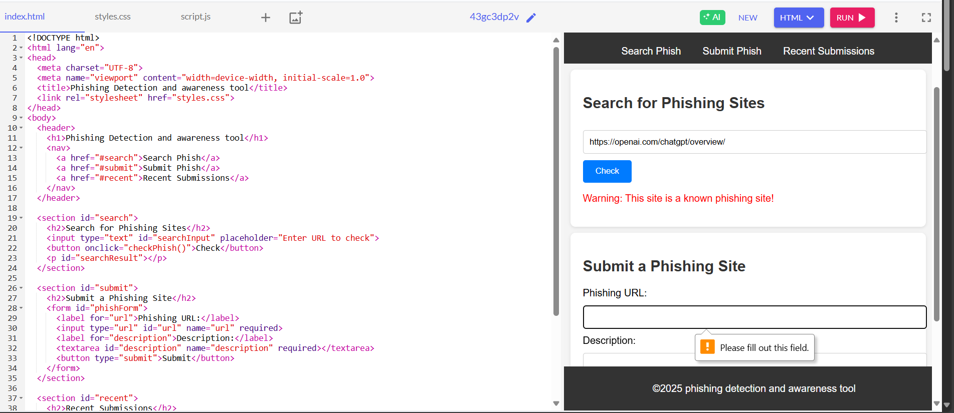
Shadow
Bytes
DEMO (IF APPLICABLE)
Sri Indu College of Engg & Tech - Cyber Club, Department of Cyber Security
Page 08

Slide 9
Shadow
Bytes
CONCLUSION & THANK YOU
✅ Conclusion
An automated phishing detection and awareness tool is both technically feasible and highly impactful. By combining intelligent email analysis with real-time training, it proactively reduces phishing risks, strengthens user behavior, and supports organizational security. With future enhancements, the system can evolve into a powerful, scalable defense platform against ever-evolving cyber threats.
Sri Indu College of Engg & Tech - Cyber Club, Department of Cyber Security
Page 09

